Slide 2
 |  | Avg. % Change in Arterial Flow after Meal Challenge |  |  |  |  | Avg. % Change in Venous Flow after Meal Challenge
 | Vessel | CONTROL (N = 20) | NEGATIVE DIAGNOSIS (N = 15) | ISCHEMIA (N = 6) |  | Vessel | CONTROL (N = 20) | NEGATIVE DIAGNOSIS (N = 15) | ISCHEMIA (N = 6)
 | SCAo | 15.7 ± 14.8 | 31.9 ± 38.5 | -2.57 ± 12.1 |  | SMV | 132 ± 80.2 | 254 ± 267 | 40.3 ± 55.6
 | IRAo | -10.0 ± 27.0 | 27.1 ± 72.4 | -3.16 ± 27.1 |  | SV | -4.75 ± 32.3 | 4.21 ± 48.2 | -11.7 ± 19.4
 | LRA | 3.58 ± 15.4 | 9.75 ± 38.8 | -19.9 ± 26.1 |  | PV | 56.7 ± 47.9 | 120 ± 153 | 11.8 ± 30.9
 | RRA | 7.00 ± 17.5 | 6.45 ± 33.2 | -35.7 ± 37.1
 | SMA | 98.8 ± 80.7 | 116 ± 163 | 23.5 ± 32.7
 | CA | 5.25 ± 52.3 | 19.0 ± 124 | 4.52 ± 8.52

Slide 4
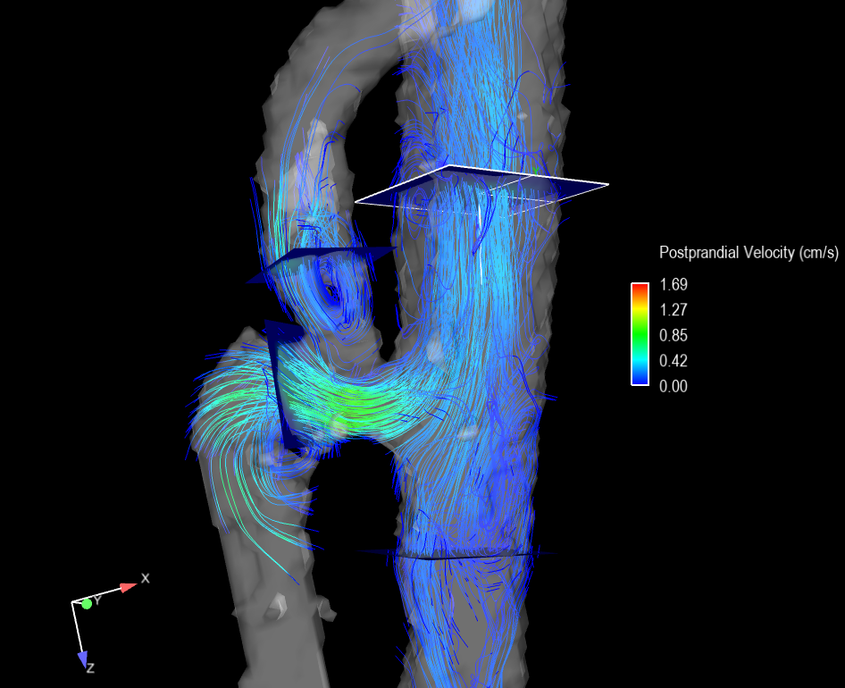
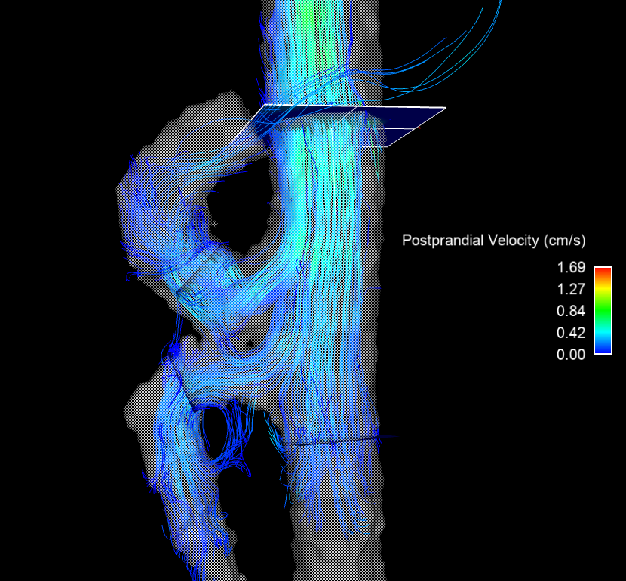
Median Arcuate Ligament Syndrome
a)
Post-surgery
b)
SCAo
b)
SCAo
CA
SMA
CA
SMA
IRAo
IRAo

Slide 5
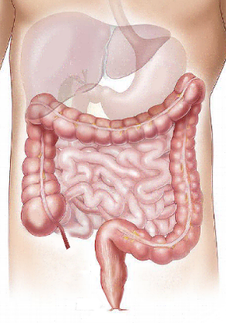
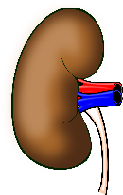
Meal Response in Control (N=20) and Ischemia Group (N=6)
Supraceliac Aorta
Portal Vein
Meal Response (Percent Change)
Control % Change: +15.7
Control % Change: +56.7
Ischemia % Change: -2.6
+100 %
Celiac Artery
Bowel
Ischemia % Change: +11.8
Control % Change: +5.3
Ischemia % Change: +4.5
0 %
Superior Mesenteric Artery
Splenic Vein
Control % Change: +98.8
Control % Change: -4.8
Ischemia % Change: +23.5
-100 %
Ischemia % Change: -11.7
Right Renal Artery
Left Renal Artery
Control % Change: +7.0
Control % Change: +3.5
Ischemia % Change: -35.7
Ischemia % Change: -19.9
Control % Change: +132.5
Ischemia % Change: +40.3
Control % Change: -10.0
Superior Mesenteric Vein
Ischemia % Change: -3.2
Infrarenal Aorta

Slide 6
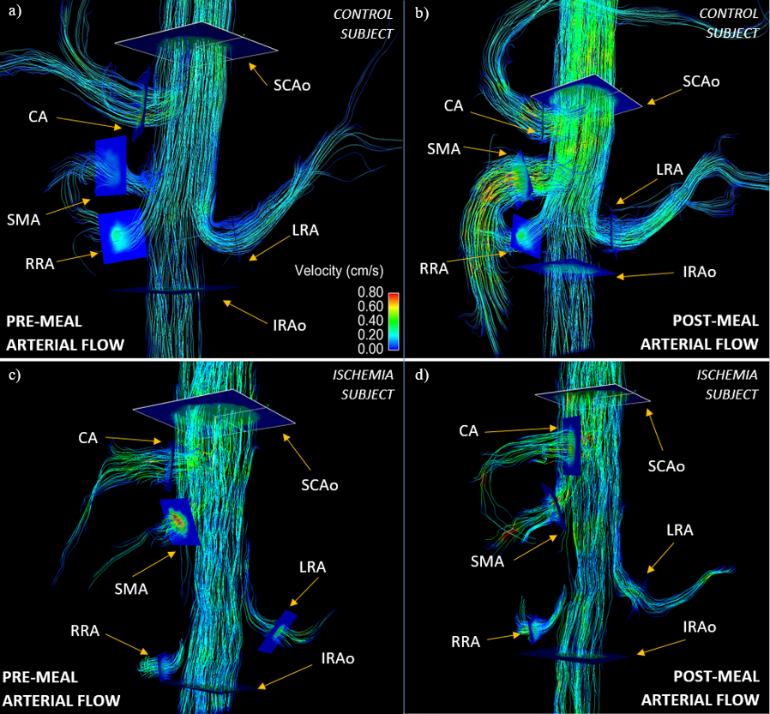

Slide 7
